Slide 1
SNF RRAM Standard Process Flow and Characterization of Lesker-2 TiN
ENGR241 Week 4 Updates
Project Members: Akash Levy, Jung-Soo Ko
Staff Mentors: Michelle Rincon, Vijay Narasimhan, J Provine, Usha Raghuram

Slide 2
Aim & Goals
Test and characterize ALD RRAM devices
Develop TiN recipe on new Lesker with low oxygen contamination
Compare TiN properties (composition, resistivity, topography)
Make electrical/imaging data and test structure layouts available to SNF
Make SOPs for RRAM stacks and report TiN findings
Process Flow Development
Parameter Optimization
Comprehensive Documentation
SNF Database

Slide 3

Tool Training Update
XPS qualification
Refresher on PT-Ox/PT-MTL
Wet bench: wbflexcorr
For sidewall/oxide/resist cleaning process
Need a bit more characterization:
Prometrix
Nanospec
P2

Slide 4
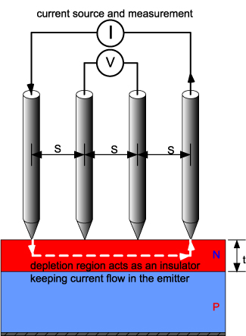
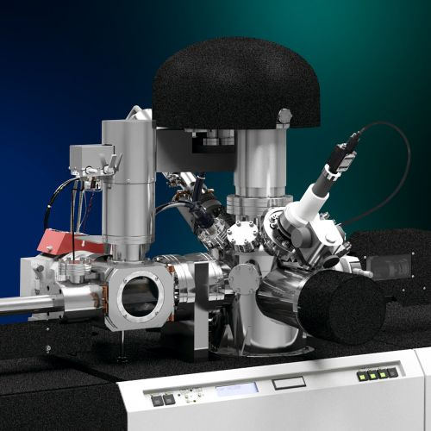
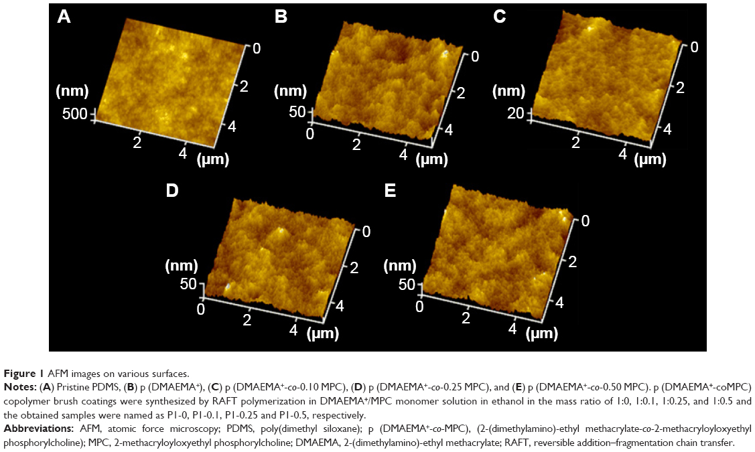
TiN Sample Preparation & Characterization
TiN
(Not drawn to scale)
SiO₂
SiO₂
Si
Si
Si
Start with Si wafer
Standard RCA Clean
Dry grow 100nm SiO₂
(thermco)
Sputter 30nm TiN
Compare 3 sputtering tools: Lesker-1 (SNF), Lesker-2 (SNF), AJA (non-SNF)
Prometrix Resistivity
XPS/Auger Composition
AFM Surface Roughness
AFM Step Height
Measure 3-4x throughout quarter to quantify oxidation over time

Slide 5
Progress Updates: Fabrication
Update: Lesker-2 expected to go live in early Feb.
RCA clean wafer
Woollam to measure native oxide thickness (11.2Å)
Dry oxide growth for 1hr in thermco4 @ 1100℃ (~100nm)
Woollam to confirm final oxide thickness (~1062.54Å, ~1052.91Å)
Exact thickness is not important, just there to insulate TiN from Si
Good quality oxide is important to get accurate TiN surface roughness
Sputter 30nm TiN (Kapton tape for step)
AJA (non-SNF)
Lesker-1 (SNF)
Lesker-2 (SNF)
AJA Characterization
XPS/Auger
Prometrix
AFM
Lesker-1 Characterization
Lesker-2 Characterization
Underlined is planned to be done by Friday
TiN
SiO₂
Si
Lesker TiN target

Slide 6
AJA TiN Sputter Recipe: Reactive Sputtering
Target: Ti
RF Power: 200W
150W also ok; different dep rates
Wafer Bias: 100V
DC bias 92-94V on AJA in practice
Ar Flow: 30 sccm
N Flow: 3 sccm
Unit conversion means that this is written as 30 on AJA somehow
Set Pressure: 2.15 mTorr
1.8-1.9 mTorr on AJA in practice
Recipe:
Load sample and wait for 1e-7 base chamber pressure
Plasma on another target (conductive) e.g. Al, GeTe
Eases plasma ignition for TiN target
Plasma on Ti target
Bias on other target off
20s ramp-up of Ti target RF power
2 minutes pre-sputtering of Ti target (shutter closed, no wafer bias)
20s ramp-up of wafer bias
Open shutter and deposit for X seconds
Close shutter
20s ramp-down of Ti target RF power

Slide 7
AJA TiN Resistivity and AFM
Kapton tape
Resistivity: Prometrix in SNF
Sheet resistance: 15.650 Ω/□
Need step height thickness measurement (to get resistivity and understand AJA deposition rate)
Step height measurement ran into some issues
Weird edge artifacts: result of tape permeation?
Sample has tape residues
Can clean tape residues and remeasure
Acetone + IPA + bake
Any other suggestions?
Also some areas where chuck blocked sputtering
Can measure step height and SiO₂ roughness
Residues
SiO₂ (?)
TiN
?
?
SiO₂ (?)
?
TiN
?
Optical microscope images

Slide 8
Literature Review
TiN films absorb a high concentration of contaminants including hydrogen, carbon, and oxygen when they are exposed to air after deposition
With the target–substrate distance set to 88 mm the contaminant levels increase from ∼0.1% to ∼10% as the pressure is increased from 2 to 9 mTorr
The contaminant concentrations also correlate with in-plane distance from the center of the substrate and increase by roughly two orders of magnitude as the target–substrate distance is increased from 88 to 266 mm
Contaminants strongly influence properties of TiN thin films
Resistivity of stoichiometric films increases by around a factor of 5 as the oxygen content increases from 0.1% to 11%
Energy of the sputtered TiN particles plays crucial role in determining the film properties
Important to precisely control the energy of these particles to obtain high-quality TiN
Ohya, S., B. Chiaro, A. Megrant, C. Neill, R. Barends, Y. Chen, J. Kelly et al. "Room temperature deposition of sputtered TiN films for superconducting coplanar waveguide resonators." Superconductor Science and Technology 27, no. 1 (2013): 015009.

Slide 9
AFM Step Height Measurements

Slide 10
AFM Roughness Measurements
Roughness: 1.02nm SiO₂
Roughness: 1.22nm TiN
0.67nm independent

Slide 11
AJA XPS Results: Surface Survey Scan

Slide 12
AJA XPS Results: Hi-Res + Depth Profile

Slide 13
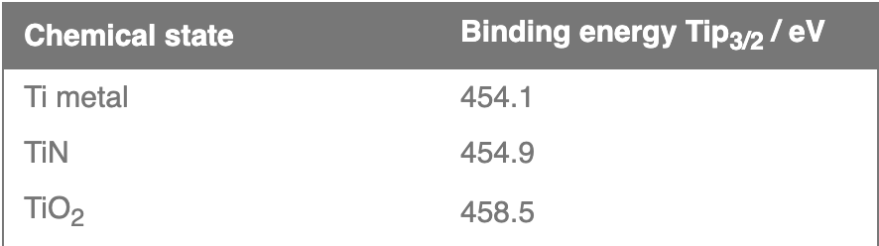
AJA XPS Results: Fitting
Ti fit has spin-orbit splitting that causes doublet peaks
Ti2p peak has significantly split spin-orbit components (Δ_{metal}=6.1eV).Splitting -value varies with chemical state (Δ_{nitride}=6.0eV, Δ_{oxide}=5.7eV).
Typically FWHM for each spin-orbit component is the same, but for Ti2p the Ti2p_{1/2} component is much broader than the Ti2p_{3/2} peak. Consequently, Ti2p_{1/2} peak is much shorter than expected.
Caused by Coster-Kronig effect. (Post-ionization, Ti2p_{1/2} state is very short lived compared to Ti2p_{3/2} state.)
Causes difficulty in accurately peak fitting Ti2p region with multiple chemical states

Slide 14
Lesker: Which Recipe? Discussion
From logbook examination, TiN isn’t used that often in Lesker
My original plan:
Master Recipe on Src 2 (TiN source) with downstream control
35 -> 5 sccm Ar to allow plasma to ignite
No other sputtering gases
(How do you adjust N pressure???)
Didn’t have enough time to run recipe ☹
Paul Comita recipe: Ti/TiN co-sputter for higher Ti concentration
Other recipes call for 3 to 5 sccm Ar with TiN target
Maybe replicate AJA recipe on Lesker-1?
XPS shows that it works super well in producing low-oxygen TiN
May not even need Lesker-2 to do good-quality TiN

Slide 15
RRAM Process Flow Outline
SiO₂
SiO₂
SiO₂
(Not drawn to scale)
Pt
Pt
Si
Si
Si
Start with Si wafer
Standard RCA Clean
Deposit 30nm Pt,
100nm SiO₂ (AJA)
Pattern trenches (PT-Ox)
Clean sidewalls of trenches
Active device area
SiO₂
SiO₂
SiO₂
SiO₂
SiO₂
SiO₂
TiN
TiN
HfO₂
HfO₂
HfO₂
Pt
Pt
Pt
Si
Si
Si
Pattern top electrodes (PT-MTL)
Clean and deoxidize TiN
Sputter 30nm TiN
Deposit 10nm HfO₂ (Fiji)

Slide 16
Process Flow Parameters
Resistive switching material (metal oxide): hafnia
Seed layer: none
Dimensions:
TiN electrode thickness: 30nm
Resistive switching layer thickness: 10nm
Device size: ﻿{1, 2, 3, 4, 5, 8, 10, 20, 40, 50} um
RS oxide growth temperature: 250C
Annealing: none
Metal oxide ALD method: thermal
TiN deposition method: sputtering
Top contact: TiN only

Slide 17
Progress Updates
Underlined is planned to be done by Friday
RCA clean wafer
Deposit 10nm Ti with AJA (skipped)
Deposit 30nm Pt with AJA
Deposit 100nm SiO2 with AJA
Woollam to check oxide thickness (834Å)
Photolithography
YES Oven for 30 mins
SVG Coat 2 with 1µm Shipley 3612 resist, 2mm EBR, skip prime step
Expose with Heidelberg: look at previous runs, logbook, exposure charts by tool (dose: 80, defoc: -2)
SVG Develop (1µm 3612 dev) w/post-exposure bake and inspect
PT-Ox: Oxide_ER_Test, 1 min
Nanospec to check etching
Matrix for resist ashing: use defaults (Strip.rcp 120s) and inspect to see if resist is removed
Metal cleaning on wbflexcorr
SRS-100 for stripping photoresist from metal wafers, 60C
PRS-1000 for final metal clean before deposition or furnace step, 40C
Fiji1 thermal HfO₂: 100 cycles standard recipe
Woollam to check oxide thickness
TiN deposition 30nm
Photolithography (see previous)
PT-MTL: still need details
Microscope to check etching
Matrix for resist ashing (see previous)
Metal cleaning on wbflexcorr (see previous)
Notes:
Dose: 70, defoc: -2 on Heidelberg-2
Dose: 80ish, defoc: -2 on Heidelberg-1

Slide 18
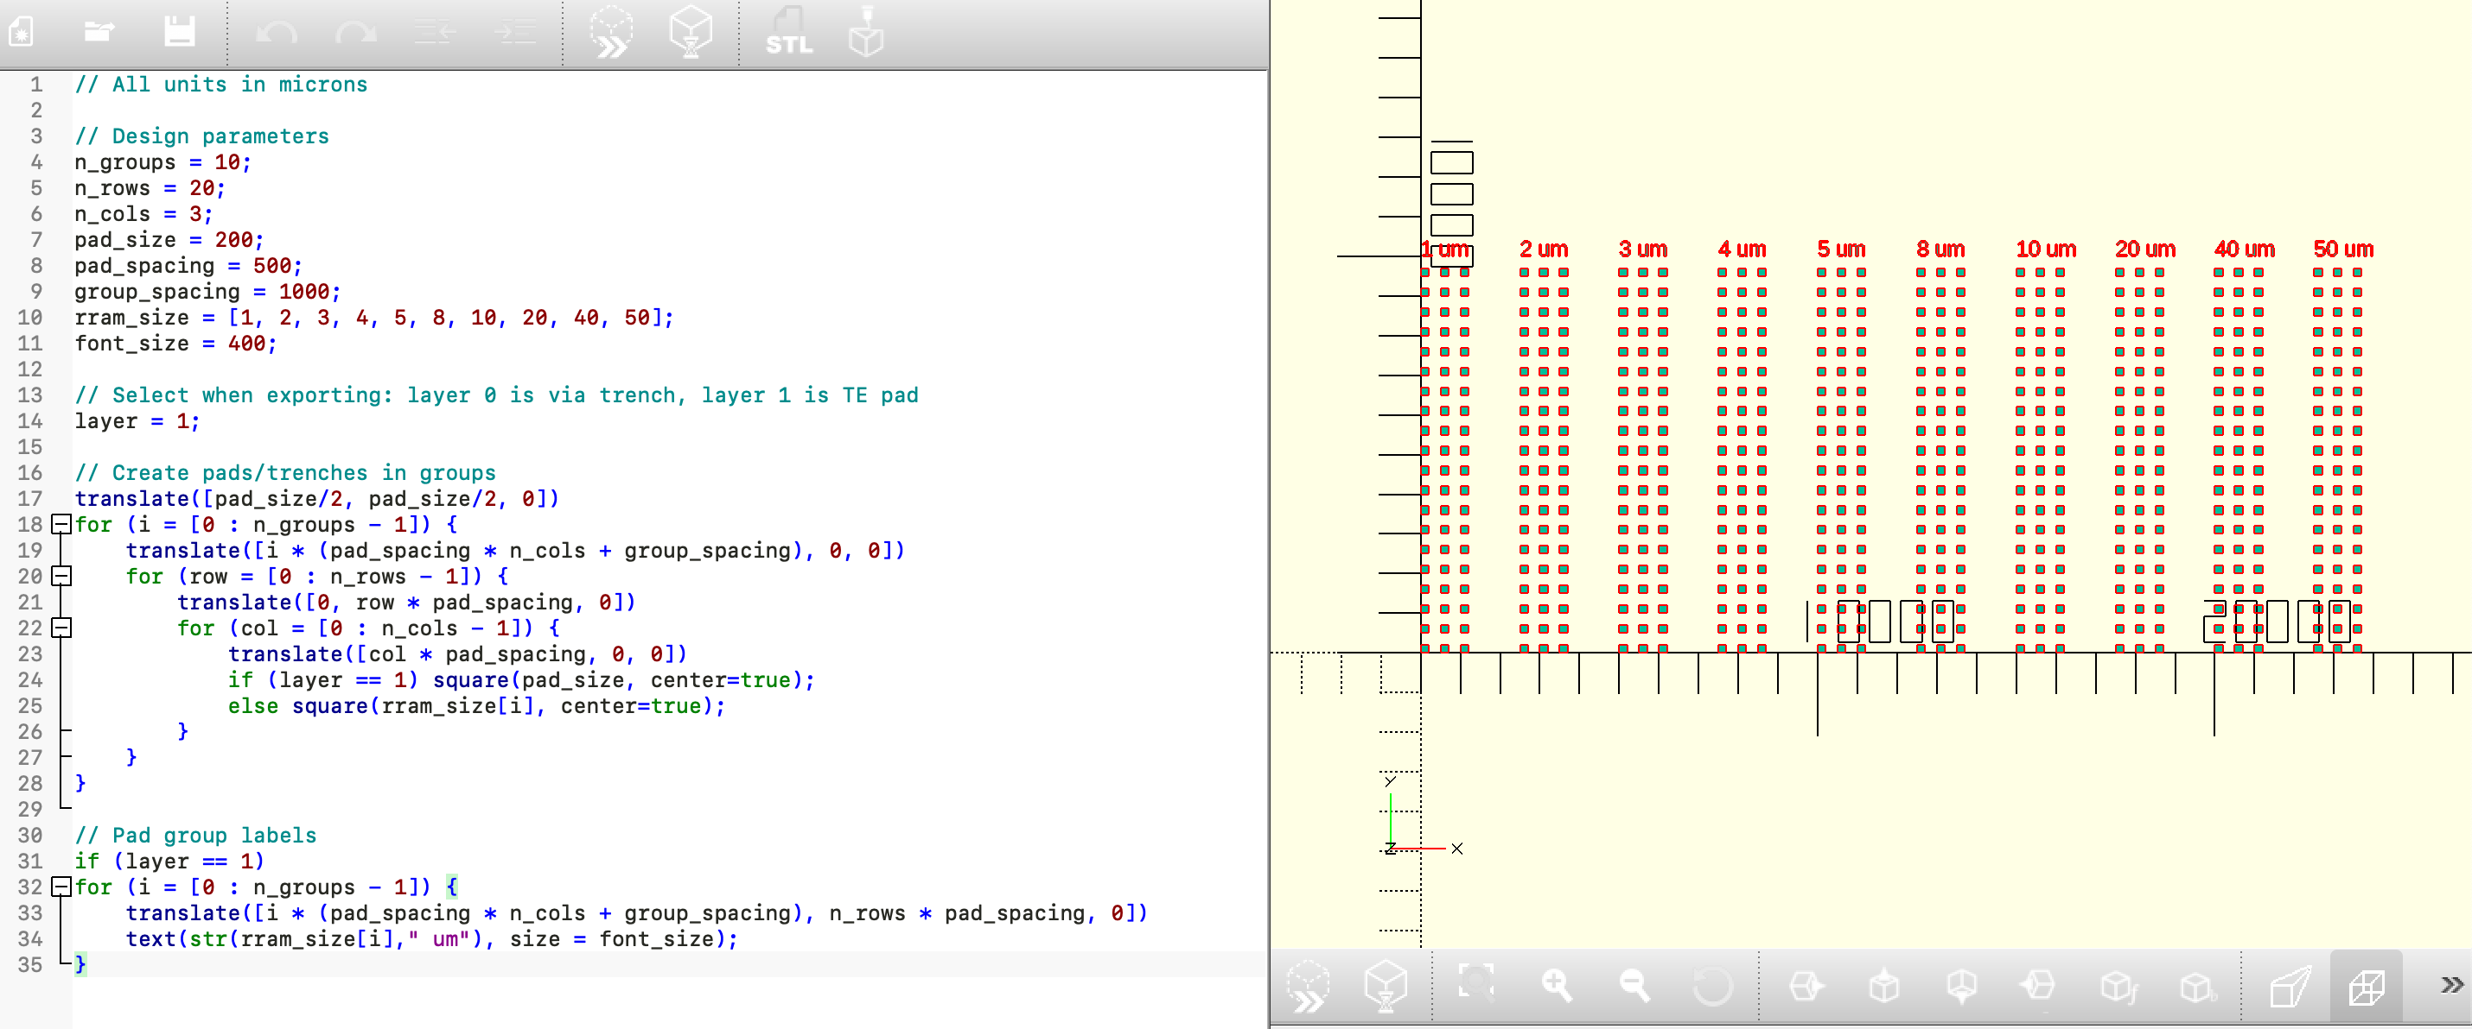
Layout Generator

Slide 19
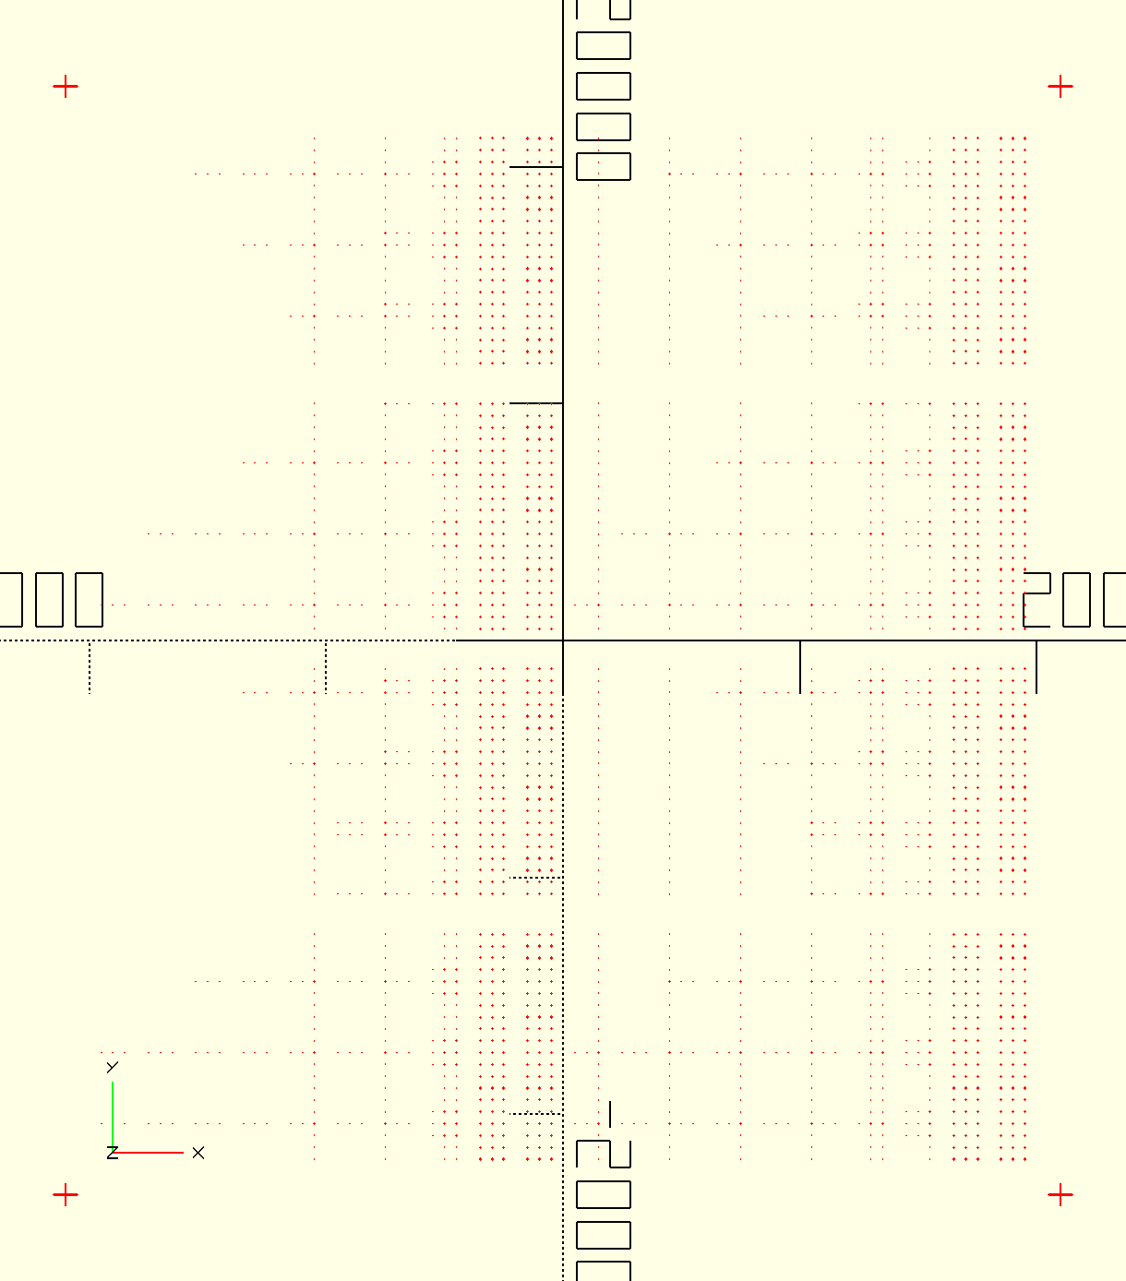
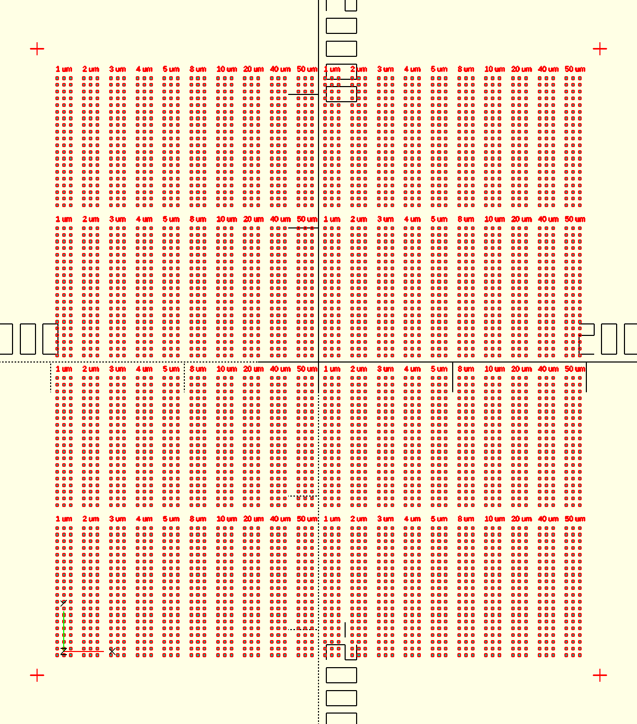
Layout Generator
Trench Layer
Top Electrode Layer
Finalized layout: alignment marks, tiling, centering about origin to make Heidelberg usage easier
Design dimensions: about 4cm x 4cm, (20x3 array) x (4x2 grid) devices per size with 10 device sizes

Slide 20
Budget
Item | Type | Time (mins) | Cost ($)
wbclean-1 | Activity | 85 | 70.83
woollam | Activity | 23 | 19.17
woollam | Activity | 12 | 10
Wafer - L-test (100 mm) | Inventory | 4 | 68
svgcoat | Training | 75 | 100
svgdev | Training | 30 | 40
XPS: PHI VersaProbe 3 | Activity | 152 | 126.67
XPS: PHI VersaProbe 3 | Training | 60 | 80
XPS: PHI VersaProbe 3 | Training | 165 | 220
TOTAL |  | 606 | 734.67

Slide 21
Thank you!
Questions?

